Slide 1
Implementing Parallel Programming Design Patterns using EFL for Python
David Dayan, Moshe Goldstein, Elad Bussani Levy, Moshe Naaman, Mor Nagar, Ditsa Soudry, Raphael B. Yehezkael
EuroPython 2016

Slide 2
agenda
Motivation
Objectives
EFL Programming Model
EFL Execution Model
EFL Implementation
Parallel Design Patterns in EFL
Conclusions
Further Work

Slide 3
Motivation
Due to the heterogeneity and incompatibility of parallel programming platforms today (MPI, openMP, Python’s Threads and Multiprocessing modules), there is a need for a common approach which will free programmers from platforms’ technical intricacies.

Slide 4
Objectives
A major objective has been to develop a straightforward language which implements this common approach, and allows implicit instead of explicit parallel programming.
This should allow flexible computation, in which sequential and parallel executions produce identical deterministic results.
To facilitate this, a deterministic parallel programming tool has been developed:
EFL (Embedded Flexible Language)

Slide 5
EFL Programming Model
… host language sequential code …
EFL{
if (a > b) {
x = f(a);
} else {
y = f(a);
}
z = g(b);
}EFL
… host language sequential code …

Slide 6
EFL Programming Model
… host language sequential code …
EFL{
if (a > b) {
x = f(a);
} else {
y = f(a);
}
z = g(b);
}EFL
… host language sequential code …
The sequential parts of the program are written in the host language.

Slide 7
EFL Programming Model
… host language sequential code …
EFL{
if (a > b) {
x = f(a);
} else {
y = f(a);
}
z = g(b);
}EFL
… host language sequential code …
Parts of the program, which are to be executed in parallel, are written as EFL embedded code.

Slide 8
EFL Programming Model
… host language sequential code …
EFL{
if (a > b) {
x = f(a);
} else {
y = f(a);
}
z = g(b);
}EFL
… host language sequential code …
EFL syntax
C-style
Host-language independent
Notes:
לא לשכח להדגיש שבגלל הגישה שד EFL יהיה משהו אוניברסלי, היינו צריכים לבחור בסינטקס מסויים, והכי נחוץ הוא הסינטקס של C

Slide 9
EFL Programming Model
… host language sequential code …
EFL{
if (a > b) {
x = f(a);
} else {
y = f(a);
}
z = g(b);
}EFL
… host language sequential code …
EFL semantics
Deterministic, like Functional Programming.
Memory management by the host language.
Implemented by translating embedded EFL blocks of code into host language parallel code.

Slide 10
EFL Programming Model
The EFL Programming Model imposes restrictions to ensure deterministic parallelization:
The programmer should call “pure” functions only (ensuring Referential Transparency).
Variables used inside EFL blocks may be of two kinds only : In or Out variables (but not InOut!).
Once-only assignments.

Slide 11
EFL Execution Model
Flexible Computation - well-defined flexible execution
A key aspect of the EFL Execution Model
Parallel and/or sequential execution orders of a program written according to the EFL Programming Model, will yield deterministic identical values.

Slide 12
EFL Execution Model
Why do we need once-only assignment?
x = 1
y = 3
EFL{
x = f(a);
y = f(b);
x = x + f(c);
}EFL
print(x)
print(y)
Results
Parallel Execution (3), (2), (1) | Sequential Execution (1), (2), (3)
x = f(a); y = f(b); | x = f(a) + f(c); y = f(b);
(1)
(2)
(3)
Note that allowing x to be IN and also OUT, leads to undeterministic results.

Slide 13
EFL Execution Model
Why do we need once-only assignment?
x = 1
y = 3
EFL{
y = f(b);
x= f(a) + f(c);
}EFL
print(x)
print(y)
Results
Parallel Execution (2), (1) | Sequential Execution (1), (2)
x = f(a) + f(c); y = f(b); | x = f(a) + f(c); y = f(b);
(1)
(2)
Note that once-only assignment prevents undeterministic results.

Slide 14
EFL Implementation: The EFL Pre-compiler
EFL
Syntax and Semantics
JAVACC
EFL-based
Host Language
Source Code
Platform-Specific
EFL
Pre-Compiler
Parallelized
Host Language
Code
Host Language
Run-time Platform
Programmer’s View
EFL Implementation View

Slide 15
EFL Implementation for python: how? Multiprocessing.Pools
A Pools object is a collection of a fixed number of child processes.
The number of child processes defaults to the number of cores in the computer.
The pool object mechanism serves as scheduler.
Includes MAP functionality.
The Pools Module was modified by us, allowing:
- unlimited hierarchy of non-daemonic processes
- Pool-based scheduling management

Slide 16
EFL Implementation for python: how? DTM module (mpi4py)
An MPI version of the EFL pre-compiler has been developed upon DTM (Distributed Task Manager) which is part of DEAP (Distributed Evolutionary Algorithms in Python) package.
DTM is a Python module written using the mpi4py module .
DTM allows EFL implicit parallel programming in a similar level of abstraction as that allowed by the multiprocessing Python module.
Includes MAP functionality.
The number of child processes defaults to the number of cores in the cluster.
A scheduling mechanism is built-in DTM.

Slide 17
Parallel Design Patterns implemented in EFL
EFL Constructs | Parallel Design Patterns
Assignment Block Pif Block | Fork-Join Pattern
For Block | Master-Worker Pattern
MapLoop Block Loop Block For Block | Map Pattern
LogLoop Block | Reduce Pattern
For Block MapLoop Block Loop Block | Filter Pattern (Map)
If Block

Slide 18
Parallel Design Patterns implemented in EFL
EFL Constructs | Parallel Design Patterns
Assignment Block Pif Block | Fork-Join Pattern
For Block | Master-Worker Pattern
MapLoop Block Loop Block For Block | Map Pattern
LogLoop Block | Reduce Pattern
For Block MapLoop Block Loop Block | Filter Pattern (Map)
If Block

Slide 19
Fork-Join Pattern
Parent-Task
Sequential Control Flow
Fork
Child-Tasks
Join
Sequential Control Flow
Notes:
Although function calls in EFL are usually executed in parallel, function calls in the condition of an if statement are not executed in parallel, but sequentially, as usual in sequential execution languages. That way, the body of the block controlled by the first true condition is executed in parallel to the rest of the EFL-block.
If the conditions were evaluated in parallel to the rest of the if-block (like they are in pif, see below), the decision of which block to execute inside the if statement would have to be delayed until the results of all the conditions are determined. This would create a barrier in the parallel execution of the whole EFL-block. Therefore, we decided that the conditions of an if statement are not evaluated in parallel.
If the programmer would like to utilize parallelization to evaluate if conditions, then he has two options: (1) to use a pif-block (see below), or (2) to write an EFL-block in which the necessary conditions are evaluated in parallel and the results are saved to variables, and then, use the results in a subsequent EFL-block.

Slide 20
Assignment block
EFL{
val1 = expr1;
… // val1, …, valI, …, valN are IN variables
valI = exprI;
… // expr1, …, exprI, …, exprN are executed
valN =exprN; // in an unspecified order (actually in parallel)
}EFL
exprI ::= someVariable | someValue | someFunc(someValue)
Note that only if exprI is a function call, a child task is generated.
Notes:
Similar to C, it is a set of assignment expressions, with variable(s) being assigned to, followed by the assignment operator (the equals sign), followed by the expression whose value is assigned to the variable(s).
Whereas in a sequential execution model language, these two statements would execute in sequence, according to their occurrence in the text of the program, in EFL they are executed in an unspecified order (actually in parallel). The benefit of this is particularly felt when used with calls to functions that are CPU-intensive.
The second example shows EFL's Assignment-block's core semantics:
the two calls to the long-running function cpuIntensiveOp are executed in parallel and their returned values are assigned to the OUT variables myVal1 and myVal2. An OUT variable cannot be used as index to an array arr,but the value returned by a function call may be used as index (for example arr[f(x)]). In this case f(x) is evaluated in parallel with other statements in the EFL-block. Likewise, if a function is called with values which are a result of function calls, then those are calculated in parallel but not the ‘outer’ function call. Note that the evaluation of such expressions in EFL is similar to the substitution model of expression evaluation in functional programming languages like Scheme [10]. In the following example, all of the calls to f are calculated in parallel:
arr[f(a)] = g(f(x) * f(y), f(z));
Only after the parallel calls to f on the r.h.s. of the assignment return their results, is g called.

Slide 21
Assignment block
EFL{
myValue1 = 5; // Simple assignment of a value
myValue2 = f(5); // Expression containing function call
}EFL
EFL{
myVal1 = cpuIntensiveFunc1(someParameters);
myVal2 = cpuIntensiveFunc2(someOtherParameters);
}EFL
Notes:
Similar to C, it is a set of assignment expressions, with variable(s) being assigned to, followed by the assignment operator (the equals sign), followed by the expression whose value is assigned to the variable(s).
Whereas in a sequential execution model language, these two statements would execute in sequence, according to their occurrence in the text of the program, in EFL they are executed in an unspecified order (actually in parallel). The benefit of this is particularly felt when used with calls to functions that are CPU-intensive.
The second example shows EFL's Assignment-block's core semantics:
the two calls to the long-running function cpuIntensiveOp are executed in parallel and their returned values are assigned to the OUT variables myVal1 and myVal2. An OUT variable cannot be used as index to an array arr,but the value returned by a function call may be used as index (for example arr[f(x)]). In this case f(x) is evaluated in parallel with other statements in the EFL-block. Likewise, if a function is called with values which are a result of function calls, then those are calculated in parallel but not the ‘outer’ function call. Note that the evaluation of such expressions in EFL is similar to the substitution model of expression evaluation in functional programming languages like Scheme [10]. In the following example, all of the calls to f are calculated in parallel:
arr[f(a)] = g(f(x) * f(y), f(z));
Only after the parallel calls to f on the r.h.s. of the assignment return their results, is g called.

Slide 22
pif -block
EFL{
pif (someBooleanExpr) {
// some code here // Boolean expressions
} elseif (someOtherBooleanExpr1) { // are evaluated in parallel.
// other code here
…
} elseif (someOtherBooleanExpr2) { // The body of the block controlled
// other code here // by the first True Boolean
}else { // expression, is executed in parallel
// last code here // to the rest of the EFL-block.
}
}EFL
someBooleanExpr ::= someExpr1 someCmpOp someExpr2
| someBooleanFunc(someValue)
Notes:
It is similar to the if block in that it provides a mechanism for conditionally executing code. Using the keyword pif, this construct allows for all of the conditions of the pif to be evaluated in parallel. The pif computes the conditions of a pif elseif else in parallel so that by the time all of the conditions’ values are calculated, the block controlled by the first true condition could be jumped to and executed. There are certain issues that must be taken into account with this approach.

Slide 23
pif -block
EFL{
pif (a==0) {
// some code
} elseif ((b / a) == c) { // possible divide by zero exception !!
// some other code
} else {
// some other code
}
}EFL
Notes:
In a sequential language, there would be no chance of a ‘divide by zero’ exception when executing this code. In a parallel execution, when all conditions are evaluated in parallel, then regardless of the result of the first condition, the second condition would also be evaluated. If in fact the value of a is zero, this would result in a run-time error. One downside of the pif is that it adds a blocking phase until all the conditions of the pif-block are evaluated.

Slide 24
Parallel Design Patterns implemented in EFL
EFL Constructs | Parallel Design Patterns
Assignment Block Pif Block | Fork-Join Pattern
For Block | Master-Worker Pattern
MapLoop Block Loop Block For Block | Map Pattern
LogLoop Block | Reduce Pattern
For Block MapLoop Block Loop Block | Filter Pattern (Map)
If Block

Slide 25
for block
EFL{
for ( i = 0; i < N ; i = i + 1) { // N is the length of Seq
Seq[i] = cpuIntensiveCalculation(i);
}
}EFL
Suppose there are M processors (or cores) in the system.
When N > M, the scheduling built into the Pools module of Multiprocessing, and in the Task Manager of DTM, allow to implicitly implement the Master-Worker pattern.
When N == M, the Fork-Join pattern is actually implemented.

Slide 26
Parallel Design Patterns implemented in EFL
EFL Constructs | Parallel Design Patterns
Assignment Block Pif Block | Fork-Join Pattern
For Block | Master-Worker Pattern
MapLoop Block Loop Block For Block | Map Pattern
LogLoop Block | Reduce Pattern
For Block MapLoop Block Loop Block | Filter Pattern (Map)
If Block

Slide 27
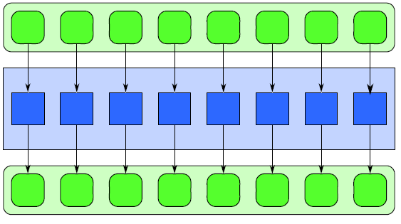
maploop block
EFL{
SeqOut = maploop(Fnc, SeqIn);
}EFL
SeqIn
Fnc
Fnc
Fnc
Fnc
Fnc
Fnc
Fnc
Fnc
SeqOut
*
* based on figure from Structured Parallel Programming – Patterns for Efficient Computation by M. McCool at el., Morgan Kaufmann, 2012.
Notes:
This construct is based on the “map” function of functional programming.
It applies a function to every element of a collection. Calculations are made on every element of the sequence and results are saved into a new sequence, not in the original one. This is trivial to parallelize because the execution of the function with a given element in the collection is independent of the execution of the function with a different element in that collection, and order of execution is irrelevant.
Although in general EFL was designed to look like a sequential imperative language like C or C++, the MapLoop was included because it helps encourage thinking about loops in a non-sequential way.

Slide 28
loop block
EFL{
:loop (i=0)
{
if (i < len(seqIn)) {
loop(i+1);
}
seqOut[i] = cpuIntensiveFunc(seqIn);
}
}EFL
This is a recursive-like implementation of the Map pattern.
Unlike sequential recursion, here every instance of the “iteration” is executed in parallel.
Notes:
In EFL, the Loop Block was created as an abstraction of loops that decouples the repetitive nature of a loop from the order of execution.
The Loop Block is declared with an identifier and an initial value for the iteration variable. That identifier (“loop” in the example) is defined by the programmer, and is not a language reserved keyword. Within the body, a recursive call is made to the loop using the identifier, and passing a new value for the new iteration variable. This provides the ability to advance the iteration using varying increments of the iteration variable. The Loop Block is “syntactic sugar” for a function declaration, and is looped through using a recursion-like execution. This style of programming is especially suited for parallel programming where all iterations of the loop are executed in parallel. The loop block views the body of the loop having its own local variables for each index value of the loop; so, all the iterations may be executed in parallel.

Slide 29
Map Pattern implemented using EFL
import math
def mapFunc(x):
return math.sqrt(x)
def parMap(seq):
EFL{
mapOut = maploop(seqIn, mapFunc);
}EFL
return mapOut
if __name__ == "__main__":
seqIn = eval(input("Enter a list of numbers > "))
if not isinstance(seqIn, list):
exit()
elif [x for x in seqIn if not isinstance(x,int)] != []:
exit()
result = parMap(seqIn)
print(result)
print('end')
Notes:
Although function calls in EFL are usually executed in parallel, function calls in the condition of an if statement are not executed in parallel, but sequentially, as usual in sequential execution languages. That way, the body of the block controlled by the first true condition is executed in parallel to the rest of the EFL-block.
If the conditions were evaluated in parallel to the rest of the if-block (like they are in pif, see below), the decision of which block to execute inside the if statement would have to be delayed until the results of all the conditions are determined. This would create a barrier in the parallel execution of the whole EFL-block. Therefore, we decided that the conditions of an if statement are not evaluated in parallel.
If the programmer would like to utilize parallelization to evaluate if conditions, then he has two options: (1) to use a pif-block (see below), or (2) to write an EFL-block in which the necessary conditions are evaluated in parallel and the results are saved to variables, and then, use the results in a subsequent EFL-block.

Slide 30
Python code generated by the EFL pre-compiler
import poolNonDaemon, multiprocessing, math, inspect
import subprocess, sys
import math
def mapFunc(x):
return math.sqrt(x)
def parMap(seq):
# -- Starting EFL Block --
EFL_pool = poolNonDaemon.Pool()
manager = multiprocessing.Manager()
queue = manager.Queue()
EFL_ANON_MAP_0 = \
EFL_pool.map_async(mapFunc, seqIn)
mapOut = EFL_ANON_MAP_0.get()
EFL_pool.close()
EFL_pool.join()
# -- Finishing EFL Block --
return mapOut
Notes:
Although function calls in EFL are usually executed in parallel, function calls in the condition of an if statement are not executed in parallel, but sequentially, as usual in sequential execution languages. That way, the body of the block controlled by the first true condition is executed in parallel to the rest of the EFL-block.
If the conditions were evaluated in parallel to the rest of the if-block (like they are in pif, see below), the decision of which block to execute inside the if statement would have to be delayed until the results of all the conditions are determined. This would create a barrier in the parallel execution of the whole EFL-block. Therefore, we decided that the conditions of an if statement are not evaluated in parallel.
If the programmer would like to utilize parallelization to evaluate if conditions, then he has two options: (1) to use a pif-block (see below), or (2) to write an EFL-block in which the necessary conditions are evaluated in parallel and the results are saved to variables, and then, use the results in a subsequent EFL-block.

Slide 31
Python code generated by the EFL pre-compiler
(continuation)
if __name__ == "__main__":
seqIn = eval(input("Enter a list of numbers > "))
if not isinstance(seqIn, list):
exit()
elif [x for x in seqIn if not isinstance(x,int)] != []:
exit()
result = parMap(seqIn)
print(result)
print('end')
#The EFL Precompiler assumes that the following methods exist and are "pure": mapFunc
Notes:
Although function calls in EFL are usually executed in parallel, function calls in the condition of an if statement are not executed in parallel, but sequentially, as usual in sequential execution languages. That way, the body of the block controlled by the first true condition is executed in parallel to the rest of the EFL-block.
If the conditions were evaluated in parallel to the rest of the if-block (like they are in pif, see below), the decision of which block to execute inside the if statement would have to be delayed until the results of all the conditions are determined. This would create a barrier in the parallel execution of the whole EFL-block. Therefore, we decided that the conditions of an if statement are not evaluated in parallel.
If the programmer would like to utilize parallelization to evaluate if conditions, then he has two options: (1) to use a pif-block (see below), or (2) to write an EFL-block in which the necessary conditions are evaluated in parallel and the results are saved to variables, and then, use the results in a subsequent EFL-block.

Slide 32
Parallel Design Patterns implemented in EFL
EFL Constructs | Parallel Design Patterns
Assignment Block Pif Block | Fork-Join Pattern
For Block | Master-Worker Pattern
MapLoop Block Loop Block For Block | Map Pattern
LogLoop Block | Reduce Pattern
For Block MapLoop Block Loop Block | Filter Pattern (Map)
If Block

Slide 33
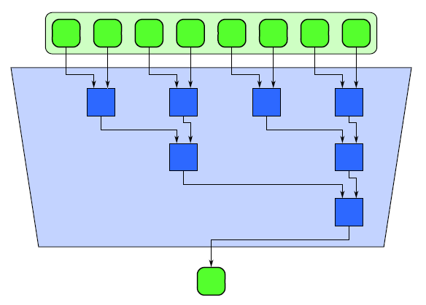
logloop -block
EFL{
result = logloop(SeqIn, Function);
}EFL
SeqIn
Fnc
Fnc
Fnc
Fnc
Fnc
Fnc
Fnc
result
Notes:
The LogLoop construct was created in order to allow performing an efficient parallel scan of a sequence. This parallel construct is implemented by a parallel algorithm that executes an operation on all values of a sequence. To do this, an algorithmic pattern based on balanced trees is used. The idea is to build a balanced tree on the input data and traverse it from the leaves to the root. A k-ary tree with n leaves has log_{k}(n) levels and therefore the running time of the algorithm is O(log_{k}(n)) where k is the number of parameters of the function, and n is the length of the sequence. One example function is addition. The algorithm works by summing every two elements in parallel, then summing every two resulting values and so on. This will produce the sum of all values of the sequence. The LogLoop Block requires the programmer to specify the function to apply and the sequence on which to apply the function. Note that the LogLoop Block is similar but more general than the high-order function Reduce, common in functional programming languages. The number of input elements for the function is dynamically detected at run-time and the algorithm acts accordingly. If the function accepts three parameters, then the running time of the algorithm is O(log₃(n)).
A graphical view of the execution of the algorithm performing addition on the numbers 1 through 8 is shown in the next slide.

Slide 34
logloop -block
EFL{
result = logloop(Sequence, Function);
}EFL
import math
def logloop (Sequence, Function):
n = len(Sequence)
Rng = range(int(math.log(n, 2))+1)
step = 1
for round in Rng:
startIdx = (2**(round+1)) - 1
previous = 2**round
step *= 2
while startIdx < n:
z = Function(Sequence[startIdx - previous], Sequence[startIdx])
Sequence[startIdx] = z
startIdx += step
return Sequence[-1]
Notes:
The LogLoop construct was created in order to allow performing an efficient parallel scan of a sequence. This parallel construct is implemented by a parallel algorithm that executes an operation on all values of a sequence. To do this, an algorithmic pattern based on balanced trees is used. The idea is to build a balanced tree on the input data and traverse it from the leaves to the root. A k-ary tree with n leaves has log_{k}(n) levels and therefore the running time of the algorithm is O(log_{k}(n)) where k is the number of parameters of the function, and n is the length of the sequence. One example function is addition. The algorithm works by summing every two elements in parallel, then summing every two resulting values and so on. This will produce the sum of all values of the sequence. The LogLoop Block requires the programmer to specify the function to apply and the sequence on which to apply the function. Note that the LogLoop Block is similar but more general than the high-order function Reduce, common in functional programming languages. The number of input elements for the function is dynamically detected at run-time and the algorithm acts accordingly. If the function accepts three parameters, then the running time of the algorithm is O(log₃(n)).
A graphical view of the execution of the algorithm performing addition on the numbers 1 through 8 is shown in the next slide.

Slide 35
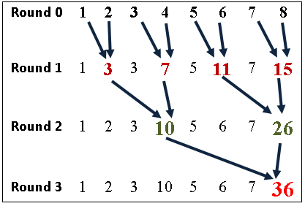
logloop -block
L = [1,2,3,4,5,6,7,8]
func = int.__add__
EFL{
result = logloop(L, func);
}EFL
print (result)

Slide 36
logloop -block
L = [[1,2],[3,4],[5,6],[7,8]]
func = list.__add__
EFL{
result = logloop(L, func);
}EFL
print (result)
[1, 2, 3, 4, 5, 6, 7, 8]
L = ['abc','erdt','wsde','xswdf']
func = str.__add__
EFL{
result = logloop(L, func);
}EFL
print (result)
'abcerdtwsdexswdf'
L = [1,2,3,4,5,6,7,8]
func = int.__mul__
EFL{
result = logloop(L, func);
}EFL
print (result)
40320

Slide 37
Parallel Design Patterns implemented in EFL
EFL Constructs | Parallel Design Patterns
Assignment Block Pif Block | Fork-Join Pattern
For Block | Master-Worker Pattern
MapLoop Block Loop Block For Block | Map Pattern
LogLoop Block | Reduce Pattern
For Block MapLoop Block Loop Block | Filter Pattern (Map)
If Block

Slide 38
Filter Pattern
def booleanFunc(x):
return x % 2 == 0
def mapFunc(x):
if booleanFunc(x):
return x
else:
return None
def parFilter(seq):
EFL{
mapOut = maploop(seqIn, mapFunc);
}EFL
seqOut = [x for x in mapOut if x != None]
return seqOut
if __name__ == "__main__":
seqIn = eval(input("Enter the input list > "))
result = parFilter(seqIn)
print(result)
Notes:
Although function calls in EFL are usually executed in parallel, function calls in the condition of an if statement are not executed in parallel, but sequentially, as usual in sequential execution languages. That way, the body of the block controlled by the first true condition is executed in parallel to the rest of the EFL-block.
If the conditions were evaluated in parallel to the rest of the if-block (like they are in pif, see below), the decision of which block to execute inside the if statement would have to be delayed until the results of all the conditions are determined. This would create a barrier in the parallel execution of the whole EFL-block. Therefore, we decided that the conditions of an if statement are not evaluated in parallel.
If the programmer would like to utilize parallelization to evaluate if conditions, then he has two options: (1) to use a pif-block (see below), or (2) to write an EFL-block in which the necessary conditions are evaluated in parallel and the results are saved to variables, and then, use the results in a subsequent EFL-block.

Slide 39
Parallel Design Patterns implemented in EFL
EFL Constructs | Parallel Design Patterns
Assignment Block Pif Block | Fork-Join Pattern
For Block | Master-Worker Pattern
MapLoop Block Loop Block For Block | Map Pattern
LogLoop Block | Reduce Pattern
For Block MapLoop Block Loop Block | Filter Pattern (Map)
If Block

Slide 40
if-block
EFL{
if (someBooleanExpr) {
// some code here // Boolean expressions
} elseif (someOtherBooleanExpr1) { // are not evaluated in parallel,
// other code here // but sequentially.
…
} elseif (someOtherBooleanExpr2) { // The body of the block controlled
// other code here // by the first True Boolean
}else { // expression, is executed in parallel
// last code here // to the rest of the EFL-block.
}
}EFL
Notes:
Although function calls in EFL are usually executed in parallel, function calls in the condition of an if statement are not executed in parallel, but sequentially, as usual in sequential execution languages. That way, the body of the block controlled by the first true condition is executed in parallel to the rest of the EFL-block.
If the conditions were evaluated in parallel to the rest of the if-block (like they are in pif, see below), the decision of which block to execute inside the if statement would have to be delayed until the results of all the conditions are determined. This would create a barrier in the parallel execution of the whole EFL-block. Therefore, we decided that the conditions of an if statement are not evaluated in parallel.
If the programmer would like to utilize parallelization to evaluate if conditions, then he has two options: (1) to use a pif-block (see below), or (2) to write an EFL-block in which the necessary conditions are evaluated in parallel and the results are saved to variables, and then, use the results in a subsequent EFL-block.

Slide 41
EFL programming examples

Slide 42
Using assignment block and if block
# sequential code
// a and b are OUT variables in this block
EFL{
a = f(x);
b = g(x);
}EFL
// a and b are IN variables in this block
EFL{
if condition1(a) {
// some code
} elseif condition2 (b) {
// some more code
} else {
// other code
}
}EFL
# sequential code

Slide 43
A nesting pattern example: multiplying a 2d matrix by a vector
def Mult(matRow,vec):
res =[0,0,0]
ret = 0
print "mult" , matRow ,"X", vec
EFL{
for (j = 0; j < len(matRow); j = j + 1) {
res[j] = matRow[j]*vec[j] ;
}
}EFL
for item in res:
ret = ret + item
print "res =", res, "->",ret
return ret
def Main():
mat = [[1,2,3],[4,5,6],[7,8,9]]
vec = [1,2,3]
print "Multiplying A Matrix And A Vector"
print mat ,"X", vec
res = [0,0,0]
print "length of mat : ", len(mat)
EFL{
for (i = 0; i < len(mat); i = i + 1) {
res[i] = Mult(mat[i],vec);
}
}EFL
print "Final result = ", res
if __name__ == '__main__':
Main()
for-loop
“iterating” upon the items of a row.
for-loop “iterating” upon the rows of the matrix.
Actually, we have a nesting of instances of the Master-Worker pattern.

Slide 44
Conclusions
Two EFL pre-compilers were implemented.
Safe and efficient parallelism has been made possible by the EFL framework.
Parallel Design Patterns have been shown to be implementable using EFL

Slide 45
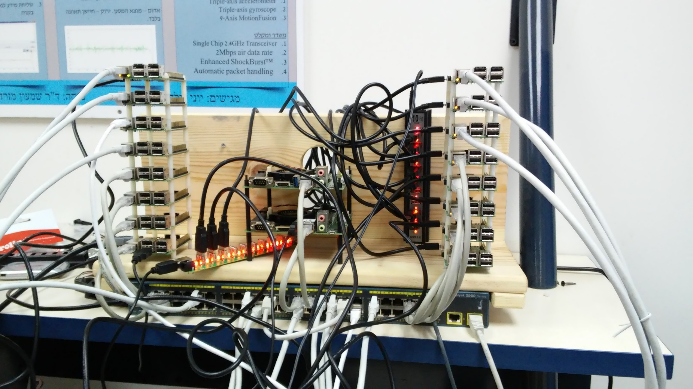
Further Work
EFL scalability will be tested using a cluster composed of 64 Raspberry-PI processors.

Slide 46
Further Work
EFL curriculum, to teach how to implement serial and parallel algorithms with EFL.
Concurrent Data Structures implementation using EFL.
Are Purely Functional Data Structures EFL-compatible?
DEEPSAM (a parallel protein structure prediction program) is in the way to be rewritten using EFL and STM (a joint project with Prof. Miroslav Popovic).

Slide 47
Invitation
We invite you to join us to:
Re-design EFL with Python-like syntax.
Implement new versions of the EFL pre-compiler for other parallel programming platforms and other host programming languages.
Implement all the Parallel Design Patterns using EFL (are there patterns that cannot be implemented within the EFL framework?).

Slide 48
The FLEXCOMP LAB Group
http://flexcomp.jct.ac.il
Faculty
Students
D. Berlowitz (past)
O. Berlowitz (past)
M. Rabin (past)
M. Nagar (past)
D. Soudry (past)
E. Bosni-Levy
M. Naaman
E. Lax (past)
R. Attia (past)
M. Goldstein
D. Dayan
R. B. Yehezkael
Sh. Mizrahi
Research Partner
M. Popovic (Novi-Sad University, Serbia)

Slide 49
Lev
Academic Center
Jerusalem
College of Technology

