Slide 1



Using Python to Keep the Lights On
Scott Reeve
Technical Director
E: scott.reeve@limejump.com
http://www.limejump.com
Notes:
Scott Reeve – Engineer, background in C, C++ ~20 years using Python for ~5 years
This is a celebration of python, talking about how we have used it to solve an important problem in energy supply
Background talk about the UK energy network and how it (and the world) is changing, where we come in, and where Python comes in

Slide 2

01
About Us
Limejump is a UK based technology-driven electricity utility providing supply, trading and aggregation services.
We deliver aggregation services in partnership with
Notes:
We work with electricity producers and consumers who are not big enough to go to the national grid, and get them money for being flexible in how they use or produce energy
National grid own and maintain the high-voltage electricity transmission network in England and Wales (Scotland has its own networks), balancing supply with demand on a minute-by-minute basis.

Slide 3
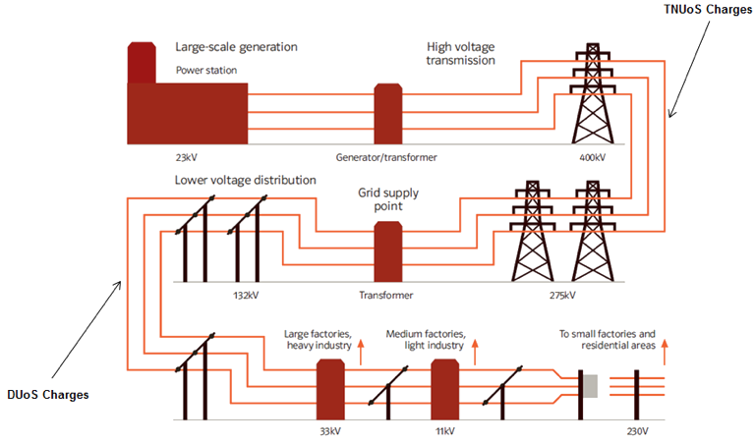
02
Traditional Power System: Status Quo Since 1870
Notes:
Traditional Power system – how it works who national grid, 1933, lots of big, coal power stations
HV backbone, goes down to lower voltage
Things changing – Climate concerns, Wind, Solar generation, Aerobic Digestion, Landfill gas, Batteries – all smaller output than traditional power stations

Slide 4

03
Virtual Power Plant: Disrupting the Status Quo
  Customers earn revenue streams for participating in grid balancing
  Enables greater integration of renewable generation onto the grid
  Helps ensure security of supply by mitigating grid frequency issues
Notes:
More localised production – smaller producers lower down the grid
Opportunity - tech
Virtual Power plant – aggregation - lots of smaller producers working together to create a large response – and as a result earning more than they could on their own
But how do they earn money? National grid must balance supply with demand

Slide 5

What is Grid balancing?
04
Notes:
Go back to the early days of power production – big steam turning a big shaft – magnetic field theory – electricity created
Frequency ~ speed of shaft (depending on number of poles)
When new power station goes on line it synchronises its frequency with the grid
If too much load – shaft slows – lower frequency
If too little load – shaft speeds up – higher frequency

Slide 6
Keeping the System Balanced: Grid Frequency
04
A mismatch in supply and demand on the electrical grid causes a shift in
frequency. If the grid balance is not rectified, a blackout will occur.
Condition | Result
Supply = Demand | Frequency = 50.0 Hz
Supply < Demand | Frequency < 50.0 Hz
Supply > Demand | Frequency > 50.0 Hz
Frequency < 49.5 or Frequency > 50.5 | Lights Out
Notes:
National grid needs to balance supply and demand – uses frequency to indicate imbalance
Examples – strong winds, power station breaking down

Slide 7
Different Products
05
We currently deliver Static frequency but are set to deliver Dynamic frequency later this year, and Enhanced in the future.
Product | Details
Static | Fixed response at pre-set threshold (49.7Hz, 50.3Hz)
Dynamic | Tracks grid frequency - 2 second response
Enhanced | Tracks grid frequency very quickly - <1 second response
Notes:
This is where we come in, working with our customers we sell a predefined amount of response to a supply demand imbalance

Slide 8


Our Technology: Overview
06
Software
  Python software at customer sites and cloud based to gather and process customer data, control customer assets
Intelligent Panel
  PLC
  3g Modem
  Quad core ARM based Linux computer
  Arduino
  Industrial power meters
Notes:
Limejump Smart Box communicates in real time with the Limejump cloud software, this information is analysed by the Optimisation engine and this data is made available for customer viewing on the Limejump customer portal.

Slide 9
Technology Diagram
07

Slide 10


Why We Use Python
08
Fast to develop
Vast selection of free libraries and frameworks
Easy to test (especially with Pytest)
Europython!

Slide 11
Issues We’ve Encountered
10
Support for concurrency / paralellism. Asyncio is good but other languages do it more elegantly.
Hard to find good permanent developers in London!

Slide 12
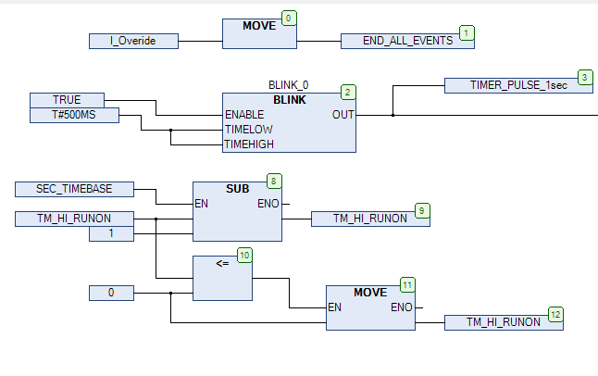
Where Python Would Be Great!
09
Limited options for using Python as a real time software language
Currently introducing embedded controllers – have to use C!
PLC – slow to program, very hard to test

Slide 13
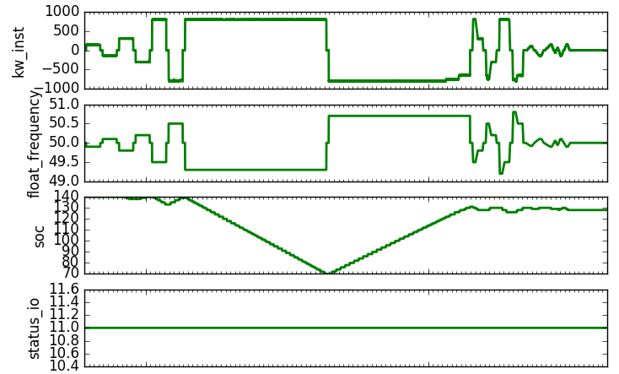
What’s Next for Limejump
11
Moving to real time data and data processing
Successfully delivering Dynamic and Enhanced FFR
More Python!

Slide 14
THANK YOU

