Slide 1
Performant Python
how to write good, fast, python code
@georgebernhard
bk@xk7.com
Notes:
I’m going to talk about “Performant Python” What does that mean? Let’s go through that step by step
Three words, equally important

Slide 2
how to write good, fast, python code
Notes:
We want to write good code. Readable code. Code with few bugs - there’s some correlation there, perhaps
That’s of course a bit vague. How do we define “good”
Lots of measurements you can do, apply pep8
I know it when I see it

Slide 3
how to write good, fast, python code
how to write good, fast, python code
Notes:
I love python, but not because it’s fast. Not to run, anyway - it’s quite fast to write
But it is fast enough - for most things I do
And it shouldn’t needlessly be slower than it has to be
Bear in mind though that computers are cheap, and programmers are expensive. If you can apply more computers to a problem, instead of programmer time, you will be better off - come back to that later

Slide 4
how to write good, fast, python code
how to write good, fast, python code
how to write good, fast, python code
Notes:
writing python since 99
from a C++ background
took a long time to transition
easy to write C in any language - but being “pythonic” and using the idioms pays off!
But what do I mean by “Pythonic”?

Slide 5
Programmers waste enormous amounts of time thinking about, or worrying about, the speed of noncritical parts of their programs, and these attempts at efficiency actually have a strong negative impact when debugging and maintenance are considered. We should forget about small efficiencies, say about 97% of the time: premature optimization is the root of all evil. Yet we should not pass up our opportunities in that critical 3%.
Donald Knuth
Notes:
Algorithms beat micro optimisations
Micro optimisations are sometimes worth it

Slide 6
import this
Beautiful is better than ugly.
Explicit is better than implicit.
Simple is better than complex.
Complex is better than complicated.
Flat is better than nested.
Sparse is better than dense.
Readability counts.
Notes:
“Zen of Python” -

Slide 7
how to write good, fast, python code
how to write good, fast, python code
how to write good, fast, python code
Notes:
There are a couple of themes that will come up through out the talk

Slide 8
pythonic
profile
do less
vectorize
cheat
parallelise
Notes:
Pythonic - clean, readable
Profile - you can’t manage what you can’t measure
Do less - the fastest, most reliable code is code that you don’t have to write
Vectorize - batching operations, incurring the overhead only once for lots of items, especially when switching between languages
Cheat - sometimes the simplest thing to do is also the right thing to do
Parallelise - multicores, cloud
So let’s get back to python performance

Slide 9
“python is slow”
Notes:
That’s something you hear bandied about a lot …. But what that actually mean?

Slide 10
“python is too slow”?
Notes:
I’d argue with that. Python is more than fast enough for most of what I do - financial numerical simulations - powerstations, at the moment
And with a few tricks, it’s fast enough for everything
Let’s look at some code

Slide 11
Notes:
Nice, simple, easy to read. Pretty unambiguous.
Is it fast? Let’s measure

Slide 12
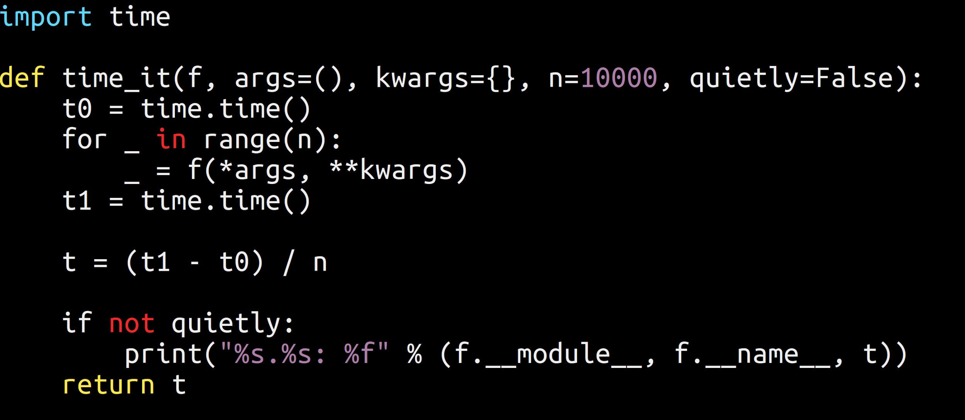
Notes:
This is not dissimilar, if not as sophisticated, as ipython %timeit

Slide 13
Notes:
Which, for 10 million numbers isnt too bad.
Certainly way faster than I could do it.
Heck, I hate to play the old man card, but the computers I grew up with couldn’t even deal with that many numbers.

Slide 14
“python is slow -
compared to C”?
Notes:
Ah. There you have it. Python is slower than C to run.
Not to write, mind you.
Which is important, because computers are cheap
Programmers are not
And you never hear about a shortage of computers..

Slide 15
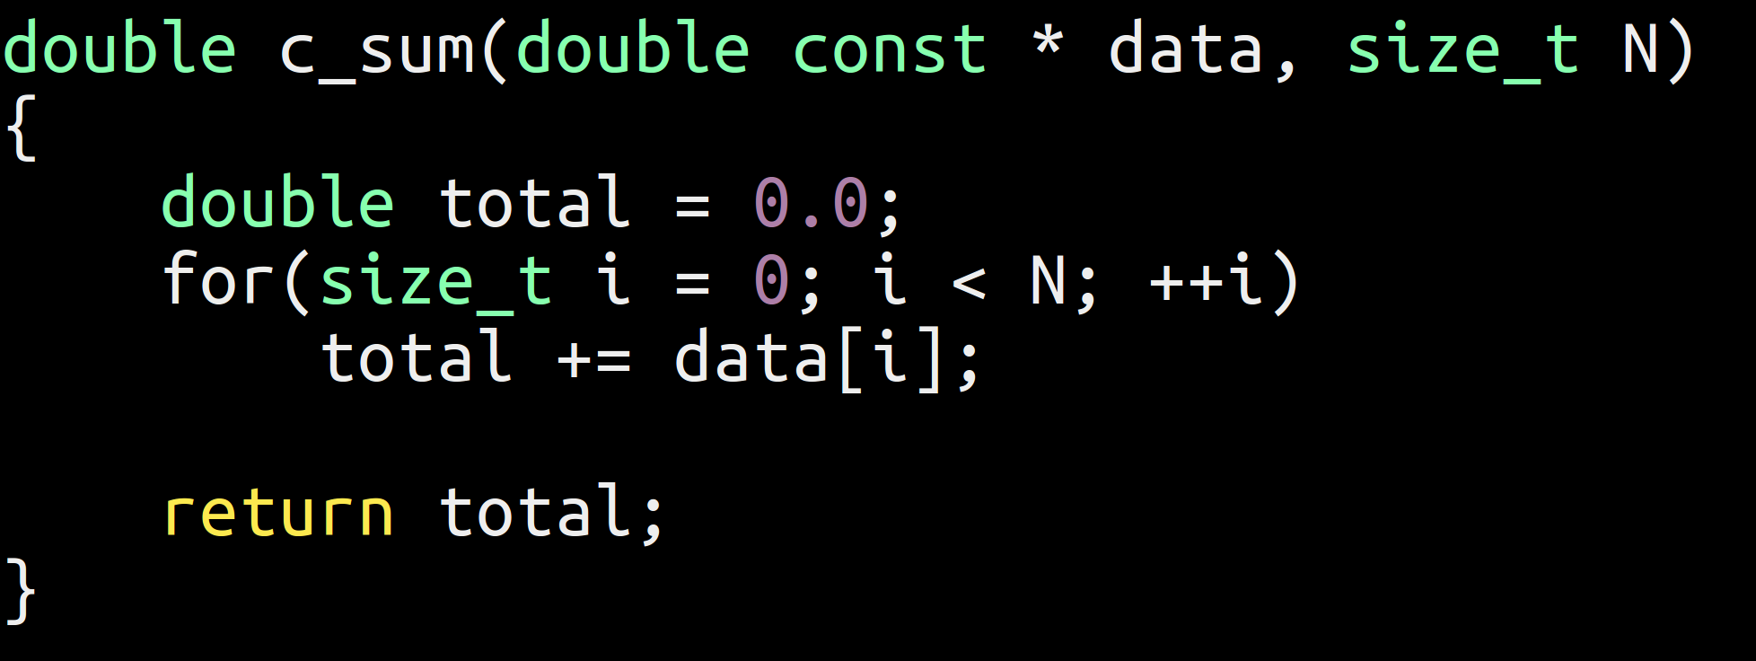
Notes:
That wasn’t so bad ;)
Let;s compare the speed

Slide 16
Notes:
Okay, this looks quite bad, superficially. 40+ times faster.. Do we really want to avoid curly braces that much?
Let’s look back at the original code

Slide 17
Notes:
This isn’t bad code - I’ve written a lot of Python code like that in my life.
But it’s not great code either. It looks like C. for starters

Slide 18
Notes:
So let’s see how we can improve that

Slide 19
Notes:
C style python - works, but not ideal

Slide 20
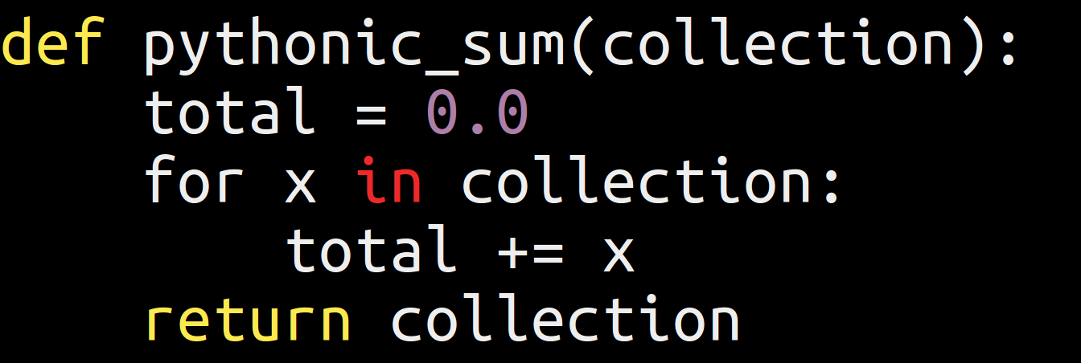
Notes:
Cleaner, simpler, shorter
Accessing lists by index is much slower than enumerating them.. Because reasons…
To me, this is kind of the canonical form of this function.
But fashion leans towards the functional

Slide 21
Notes:
Not a HUGE fan of that one, but functional programming is very fashionable at the moment, and I’m nothing if not a dedicated follower of fashion...

Slide 22
Are we faster yet?

Slide 23
Notes:
100% performance improvement!!! For code that’s no harder to read!
But still 20* slower than C++ (boo, hiss)
But of course Python already has a sum function that’s written in optimised C - remember I mentioned vectorizing earlier - if we take the whole collection and pass it off to C in one go, it should be faster

Slide 25
Notes:
And hey presto, we’re in the same ball park. But still 3 times slower
We have a few more tricks up our sleeve, though
This is what I do at work

Slide 26
Notes:
Okay, cheating slightly, it’s actually

Slide 28
Notes:
So we’ve actually beaten C++. Which is pretty neat (but may be more down to how rusty my C++...or how good the numpy guys C++ is)

Slide 29
pythonic
profile
do less
vectorize
cheat
parallelise

Slide 30
C-Python
Notes:
So we’ve actually beaten C++. Which is pretty neat (but may be more down to how rusty my C++...or how good the numpy guys C++ is)

Slide 31
Pypy
Notes:
So we get huge gains with just switching to a JIT. Now, Pypy is just one of the several available - numba is optimised for numerics, handles GPUs

Slide 32
pythonic
profile
do less
vectorize
cheat
parallelise
Notes:
We’ve kind of cheated the question “is python slow” in two ways
Pypy - the question is really is cpython slow.
Using numpy - we’re basically doing all the work in C++

Slide 33
good artists copy;
great artists steal.
Notes:
Picasso, Tennyson, Jobs?
No prizes for building a bad wheel when there’s a great wheel you could use instead.
Let’s move on to another theme

Slide 34
pythonic
profile
do less
vectorize
cheat
parallelise

Slide 35
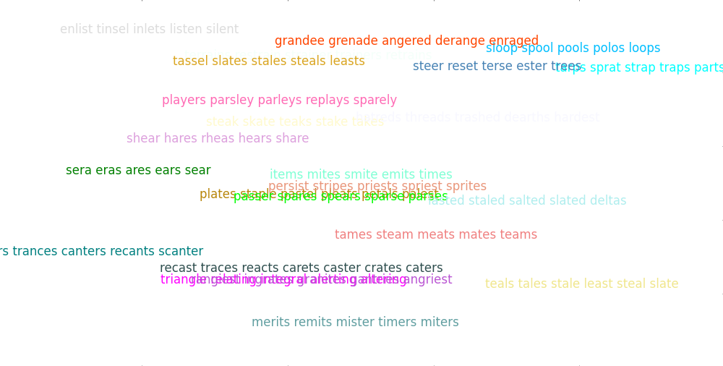
Notes:
These are only very vaguely amusing - it’s how people kept themselves entertained before they had the internet
But working them out is very tedious and time consuming, so why don’t we get our computer to do it for us?

Slide 36
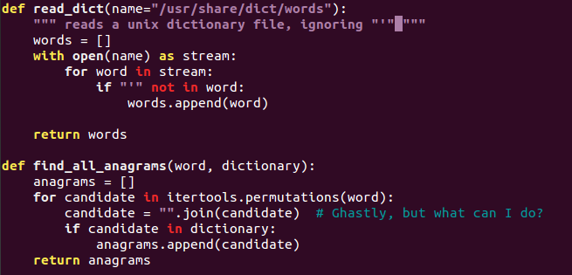
Notes:
“”.join() is one of the relatively few things i really don’t like about python
Anway, this is nice and simple. Easy to read. Uses itertools.permutations - no need to reinvent the wheel

Slide 37
anagram0.py
works
didn’t take long to write
Notes:
Let’s not underestimate that
It works and does what we want - there’s a lot of software that doesn’t do that
It didn’t cost much time to write.
But how fast does it run?
We add a bit of code that executes our anagram finder a few times… and time it

Slide 39
Notes:
On Unix, we have the time tool - on Windows you can get it with Cygwin
So 1 minute 14.4 seconds real, elapsed, wall clock time.
Faster than I could do it, but seems a bit slow.
Now, this is Python 3.4 - let’s check if old fashioned, reliable 2.7 is any better

Slide 40
Python 2.7 FTW!
Notes:
And it is
[this is a special case - don’t stick with 2.X because it’s faster. It usually isn’t, and 3 is a nicer language!]
But can we do better? Pypy is supposed to be fast - after all, it’s a proper JIT. So let’s try that...

Slide 41
PyPy FTW FTW!
Notes:
Magic! So we’ve gone from 74 seconds to 22 seconds without having to do any work. And we’re using Python3.
Result - let’s go home! ;)
---
Seriously - this may be a good place to stop if that is “fast enough”. That depends entirely on the context!
If it isn’t, the next step profiling - finding out where the time actually goes.

Slide 42
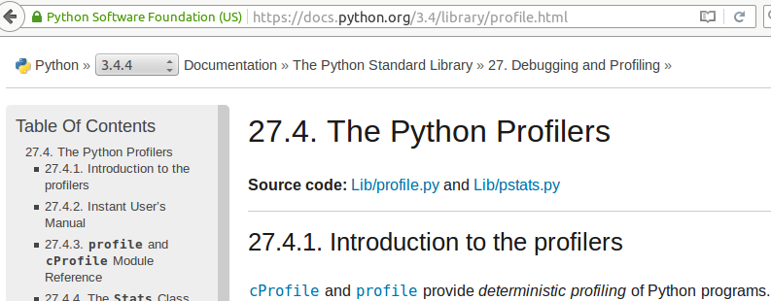
Profiling
Notes:
Batteries included
And really easy to use

Slide 43
Batteries included!

Slide 44
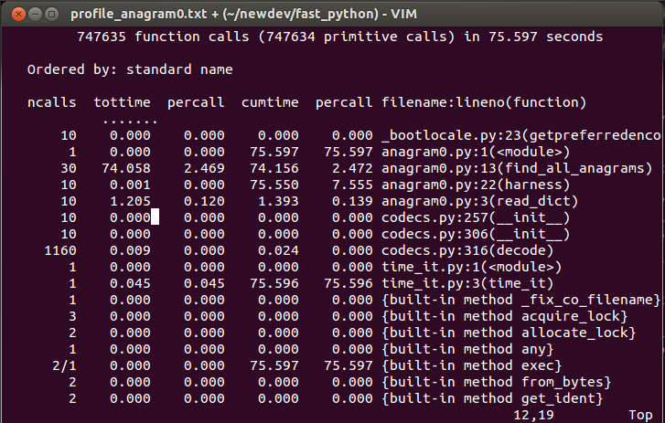
Notes:
So, as we expect, almost all the time is spent in find_all_anagrams()
So let’s look at that again

Slide 45
Notes:
I can’t obviously see what’s taking up the time here. I could speculate - but, better yet, we can measure it.
Enter line profiler:

Slide 46
Notes:
Not quite included, but easily installable [unless like me you’re sitting behind a paranoid firewall]
Once you’ve installed it, there are just two small steps:

Slide 47
Notes:
Decorate your function with @profile
Run kernprof

Slide 48
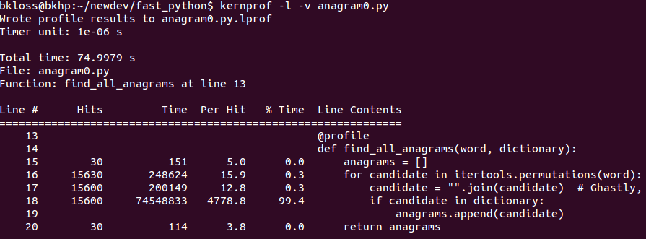
Notes:
2. run kernprof
and then you get a nicely annotated code listing
I often find the hit count quite enlightening, both with lineprof and the standard profiler. Hmml… why does this function get called a billion times? What’s going on there? - different perspective on your codes behaviour
Back to anagrams: All the time is spent in line 17.
Linear search. O(N) - in a for loop. Quadratic algorithm. This is really bad.
Fortunately - batteries included - has data structures that has O(1) lookup. In this case, we want a set()

Slide 49
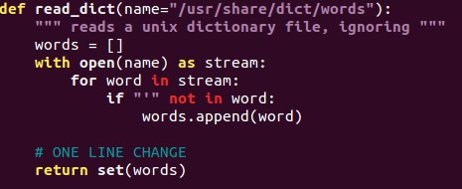
Notes:
One line change

Slide 50
52 x faster - Datastructures FTW!
Notes:
60x faster, one line of code changed
Or a fundamental data structure… if you look at it from that perspective.
But still, the effort of profiling really paid off

Slide 51
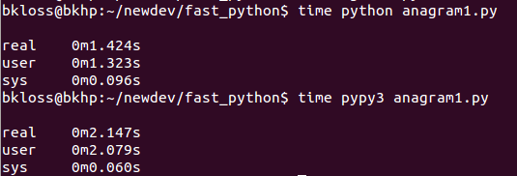
Notes:
Interesting note here - pypy doesn’t give us a free speedup here anymore. A JIT compiler has some initial overhead, and the whole program now executes to quickly to make the overhead worthwhile.
So, what are we doing? If we only want to calculate a handful of anagrams - let’s stop and go home.
But if we want to calculate lots and lots of them, all the time, it’s worth getting more efficient about it!
What can we do upfront to make individual calculations more efficient?
So, this is great. We managed to get huge performance gains with really little work, learned something useful about python profilers. Swell. But it’s still taken us ~ 1.5s to calculate 10 * 3 anagrams - 1/20s per anagram! that’s a huge amount of time for a computer.

Slide 52
pythonic
profile
do less
vectorize
cheat
parallelise

Slide 54
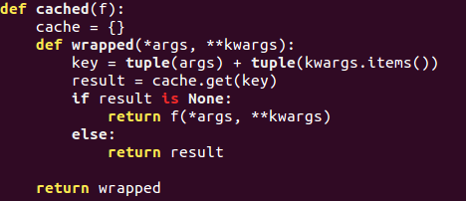

Slide 55
pythonic
profile
do less
vectorize
cheat
parallelise

Slide 56
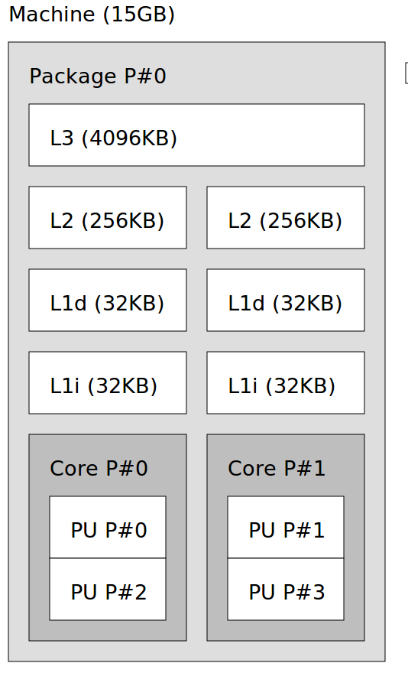
Parallelisation

Slide 57
Programmers are expensive
Computers are cheap

Slide 58
Programmers are expensive
Computers are cheap
Lots of problems are embarrassingly parallel

Slide 59
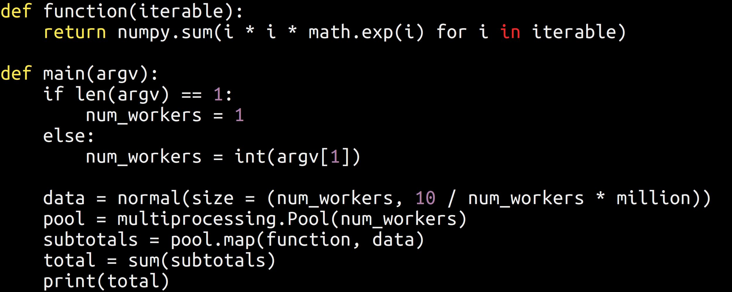
Notes:
This will use all the cores you have
It’s also relatively simple to scale up to multiple computers in Python (AWS, Azure)

