Slide 1
20 Years without a ‘proper job’
Rachel Willmer

Slide 2

This TALK IS FOR YOU IF…

Slide 3
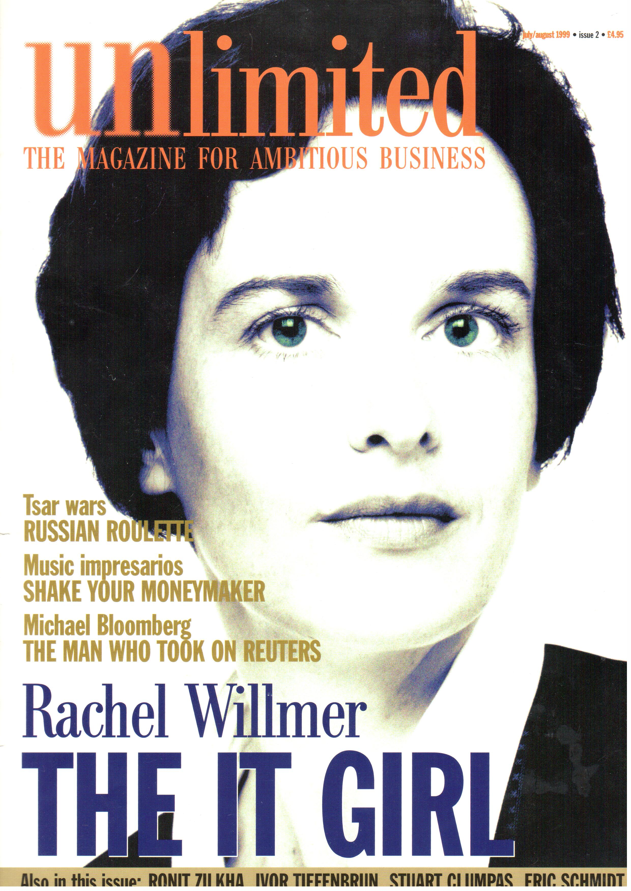
Who Am I TO TALK?

Slide 5
Back To You…
What could You DO?

Slide 6
Product?
Ebook, Course, Online Training, Wordpress Plugin
One-Off Revenue
No Support
Good for side-project or first project

Slide 7
Service?
SAAS
Recurring Revenue
Support Costs
Better when full-time

Slide 8
Publish
Blog
YouTube Vlog
Podcast

Slide 9
How To Monetise
Sale of book
Affiliate Commission
Advertising
Sponsorship
Data Analytics

Slide 10
  Some Examples

Slide 11
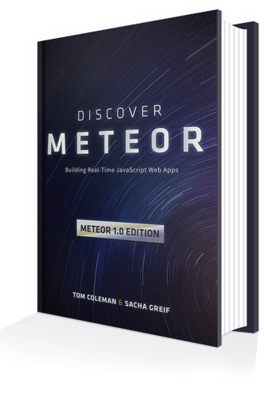
You can’t Make Money by writing a book
No?
Tell that to Sacha Grief & Tom Coleman
$300k (in 18 months)
Self-published via Gumroad

Slide 12

You CAn’t start a serious business as a solo founder
Peldi from Balsamic did.
Annual profits > $2m

Slide 13
You Can’t DO THIS UNLESS YOU LIVE IN THE USA
Patio11 did it from Japan
(by the way, he’s amazing…)

Slide 14

I can’t do it because…
Yes. You can.
Let me introduce you to Jon Morrow.

Slide 15

Jon Morrow
has Spinal Muscular Atrophy
cannot move from the neck down
runs smartblogger.com, writes amazingly good copy, makes a ton of money, and has a lot of fun!

Slide 16
And Finally
OK to START SMALL
You Don’t LEARN Until You Start To Fail
Don’t be Afraid to THINK BIG
Choose B2B and Charge More
Choose The Customers You Want
Charge More (Yes Really!)
and above all…
START A MAILING LIST

Slide 17
ANY QUESTIONS?
rachel@willmer.org
Twitter: @rwillmer
luzme.com
readyourselfsmarter.com

